Slide 1
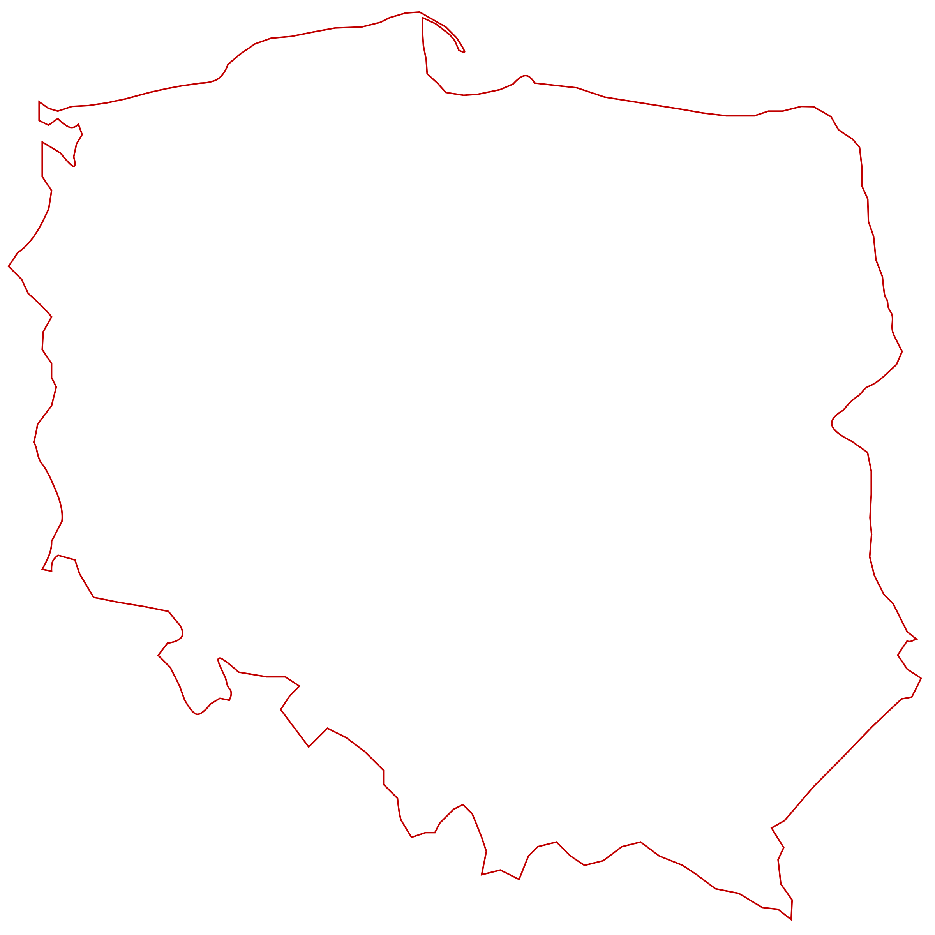

Golang Poland Meetup #3
GoBridge

Slide 2
Agenda
1. Infrastructure for Machine Learning - Natalie Pistunovich 2. 10 Grab coffee/beer break
3. Building event-driven applications with Watermill - Robert Laszczak
4. [lightning] GoSwagger in production: wins and pitfalls – Ilya Kaznacheev
5. Your announcements || Engineer lost & found
6. Socialising in Breakouts room

Slide 3
Questions?
Join channel #poland on gophers.slack.com.
https://invite.slack.golangbridge.org

Slide 4
Good Questions/Answer = JetBrain license

Slide 5
Please ask your colleagues
Speakers wanted.

Slide 6
Please ask your colleagues
We look for ideas. It is your meetup.

Slide 7
Where to find us?
meetup.com/Golang-Poland
meetup.com/GoCracow
meetup.com/Golang-Warsaw
Slack: #poland channel na gophers.slack.com
Slides: https://github.com/golangpoland/meetup_golang_warsaw

